Slide 1
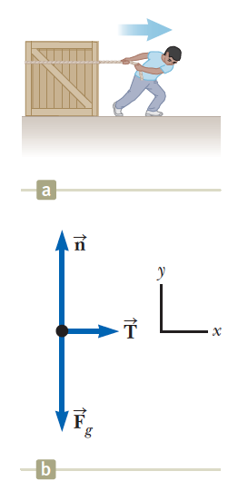
Applying Newton’s 2nd law:
A man pulls a cargo box of mass 20 kg with an acceleration of 2 ms⁻² on a smooth surface. Find the tension of the rope and the normal force acting on the cargo box.
Draw the free body diagram.
Let rightwards and upwards be positive in x- and y-directions respectively.
For x-direction,
For y-direction,

Slide 2

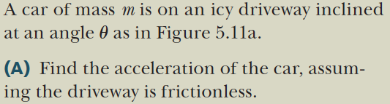
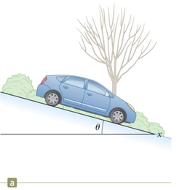
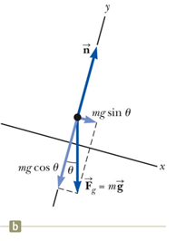
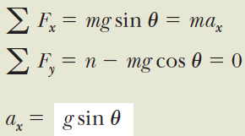
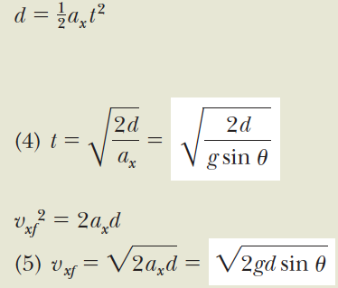
Objects under net force

Slide 3
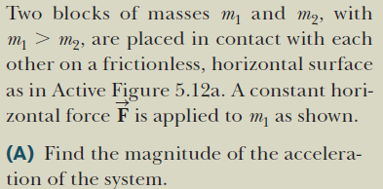
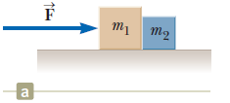
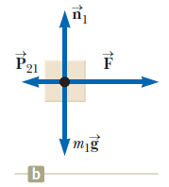
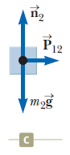
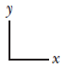
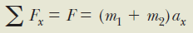
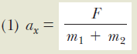
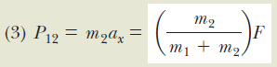
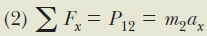
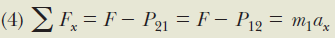
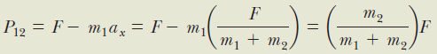

Slide 4
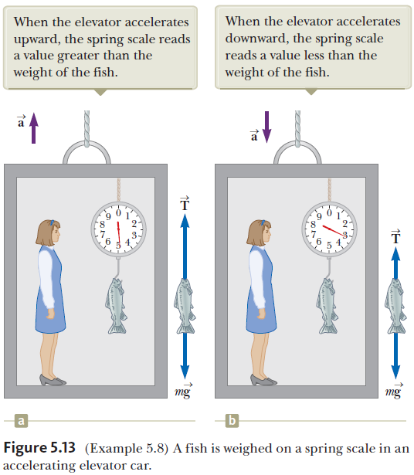
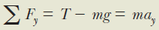
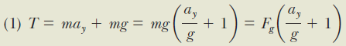

Slide 5
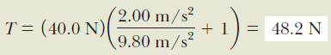
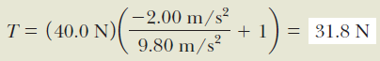

Slide 6
Weightless!

Slide 7
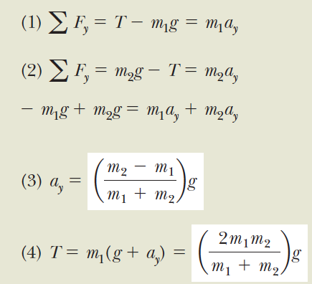
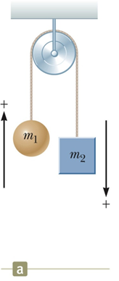
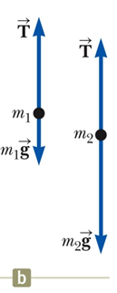
Multiple Objects

Slide 8
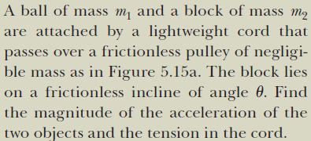
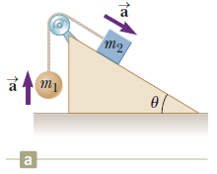
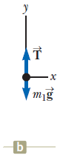
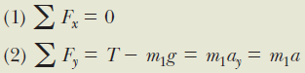
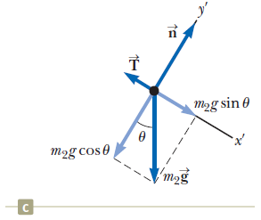
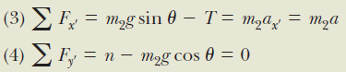
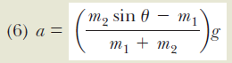
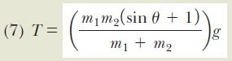
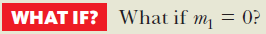

Slide 9
Forces of Friction
When an object is in motion on a surface or through a viscous medium, there will be a resistance to the motion. This resistance is called the force of friction.
Experiments show that friction is proportional to the normal force, is opposite the direction of motion and parallel to the surfaces in contact.
ƒ_{s} ≤ µ_{s} n and ƒ_{k}= µ_{k} n
μ is the coefficient of friction; n is the normal force
These equations relate the magnitudes of the forces; they are not vector equations.

Slide 10
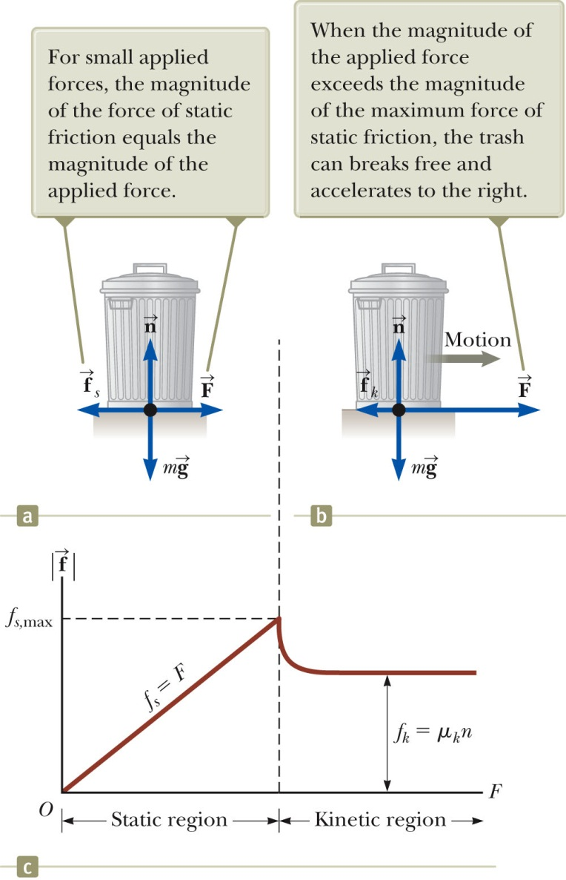
Static Friction
Static friction acts to keep the object from moving.
As long as the object is not moving, ƒ_{s} = F
If increases, so does
If decreases, so does
ƒ_{s} ≤ µ_{s} n
Remember, the equality holds when the surfaces are on the verge of slipping.

Slide 11

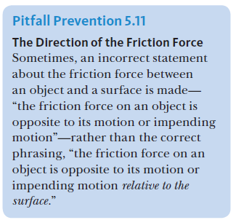
Kinetic Friction
The force of kinetic friction acts when the object is in motion.
Although µ_{k} can vary with speed, we shall neglect any such variations.
ƒ_{k} = µ_{k} n

Slide 12
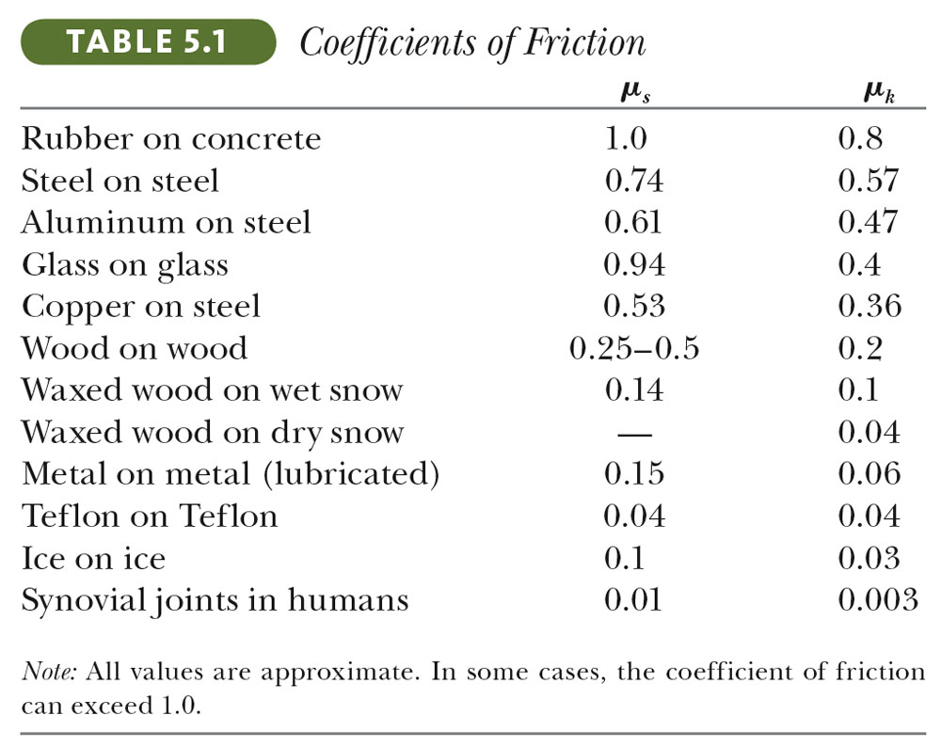
Some Coefficients of Friction
Section 5.8

Slide 13
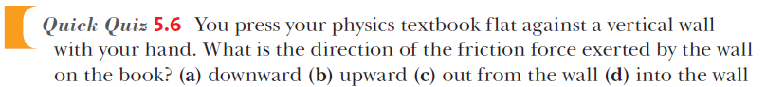
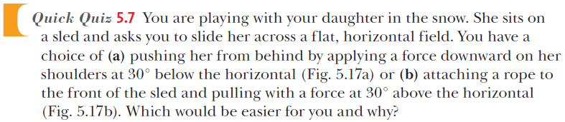
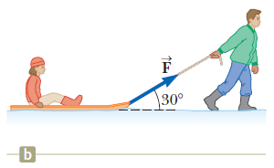
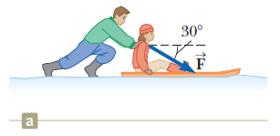
Think about it!

Slide 14
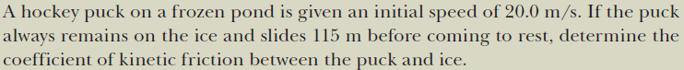
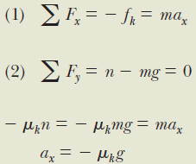
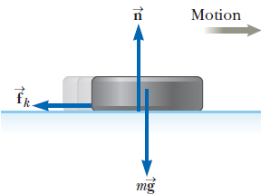
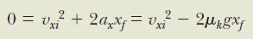
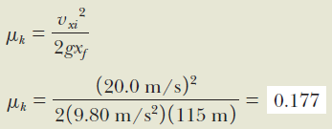

Slide 15
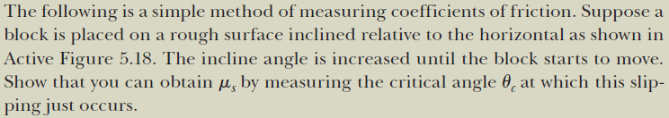
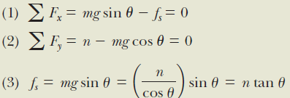
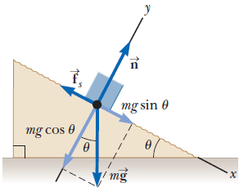
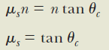

Slide 16






Example 5.13
Notes:
IDENTIFY and SET UP: The crate is in equilibrium both when it is
at rest and when it is moving with constant velocity, so we use
Newton’s first law, as expressed by Eqs. (5.2). We use Eqs. (5.5)
and (5.6) to find the target variables and
Figures 5.20a and 5.20b show our sketch and free-body
diagram for the instant just before the crate starts to move,
when the static friction force has its maximum possible value

Slide 17


Example 5.13 Static
Notes:
IDENTIFY and SET UP: The crate is in equilibrium both when it is
at rest and when it is moving with constant velocity, so we use
Newton’s first law, as expressed by Eqs. (5.2). We use Eqs. (5.5)
and (5.6) to find the target variables and
Figures 5.20a and 5.20b show our sketch and free-body
diagram for the instant just before the crate starts to move,
when the static friction force has its maximum possible value

Slide 18


Example 5.13 Kinetic
Only holds for constant velocity!
Notes:
IDENTIFY and SET UP: The crate is in equilibrium both when it is
at rest and when it is moving with constant velocity, so we use
Newton’s first law, as expressed by Eqs. (5.2). We use Eqs. (5.5)
and (5.6) to find the target variables and
Figures 5.20a and 5.20b show our sketch and free-body
diagram for the instant just before the crate starts to move,
when the static friction force has its maximum possible value

Slide 19





Slide 20




Slide 21


Slide 22



Slide 23






Slide 24






Slide 25








（1）
（2）
（3）

Slide 26


Slide 27


Slide 28






Section 5.8

Slide 29


Slide 30


Slide 31


Slide 32


Slide 33


Slide 34


Slide 35


Slide 36


Slide 37






Example 5.23: Uniform circular motion in a vertical circle
Note:
n_{T} & n_{B} are nonnegative
Directions of n are opposite to a_{y}

Slide 38



Example 5.23: Uniform circular motion in a vertical circle
At top
So:

Slide 39



Example 5.23: Uniform circular motion in a vertical circle
At bottom
So:

Slide 40






Force in uniform circular motion

Slide 41




Example 5.20: A Conical Pendulum
plug in F

Slide 42

Example 5.20: A Conical Pendulum

Slide 43

Example 5.20: A Conical Pendulum

Slide 44


Slide 45







Example 5.22: Rounding a banked curve

Slide 46




Laws of Motion

Slide 47






Summary (will be tested)

